Slide 1

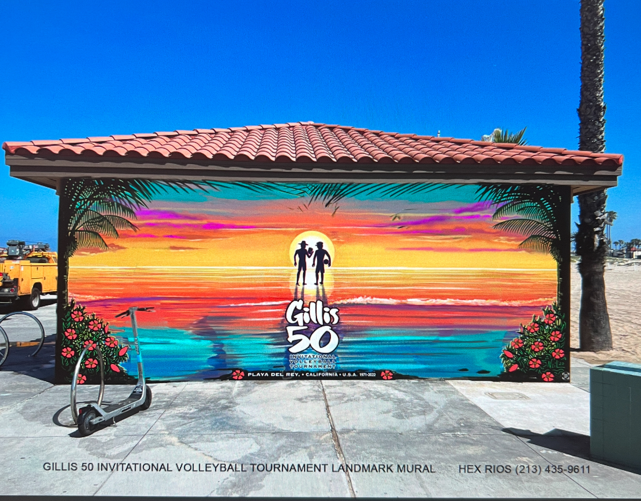
CD11 Dedication Mural

Slide 2
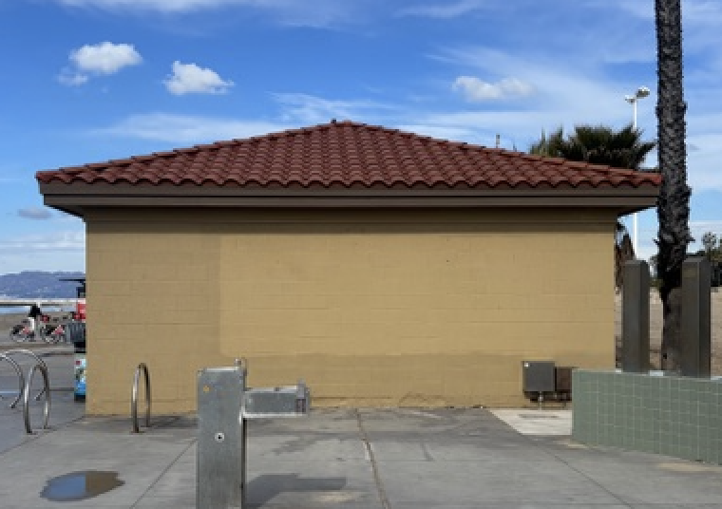
Before & After

Slide 3
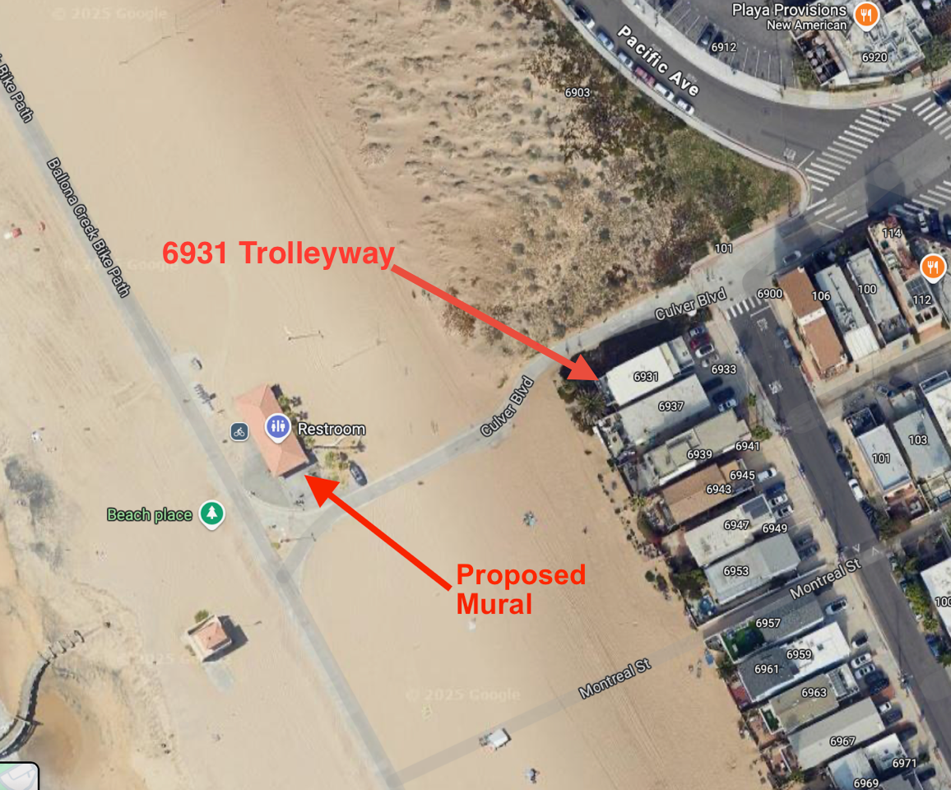
Location in Playa Del Rey

Slide 4
Gillis History
In 1971, brothers Steve and Dave Cressman launched The Gillis Invitational Volleyball Tournament in Playa del Rey. Friends from local high schools got together and launched the first event with the creation of seventeen 2-man teams.
Eventually, the goal of the tournament was to get everyone playing, no matter their skill level. The tournament evolved to include multiple brackets like The Hoffy, the 6-Man, the 4-man, and more.
Councilwoman Traci Park is dedicating a mural to Steve and Dave Cressman and The Gillis in commemoration of 50 years of community service to Playa del Rey.

Slide 5
Approvals & Permits
APPROVALS
CITY: Board of Recreation and Parks Commissioners
PERMITS
CITY: Right of Entry
COUNTY: Right of Entry

Slide 6
Budget & Funding
BUDGET
Mural .……...... $4500
Maintenance.. $1000
(Graffiti: Power wash, Apply Mural Shield)
Permit Fees…. $1100
TOTAL…. $6600
FUNDING
CD11 Foundation
Private Donations

Slide 7
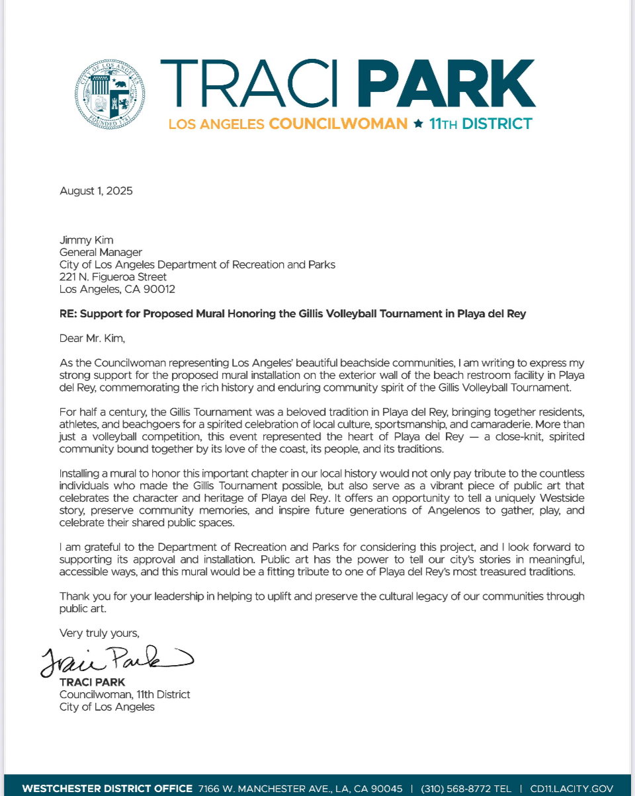
Outreach & Support

Slide 8
NCWP Request
We are requesting a mural support letter from the NCWP.

Slide 9
Thank you for your consideration.
For more information, please contact:
Trey Grogan
Council District 11
Trey.grogan@lacity.org
310-568-8772
Lucy Han
Friends of the Jungle
lucy@fotj.org
310-292-1225

