Slide 1
Westchester/Playa CPU DRAFT 2 MAPS
STAKEHOLDER RESPONSE TO PLANNING WORKBOOK COMMERCIAL MAP STUDY
Prepared by Kimberly Fox, Cory Birkett
Community Stakeholders

Slide 2
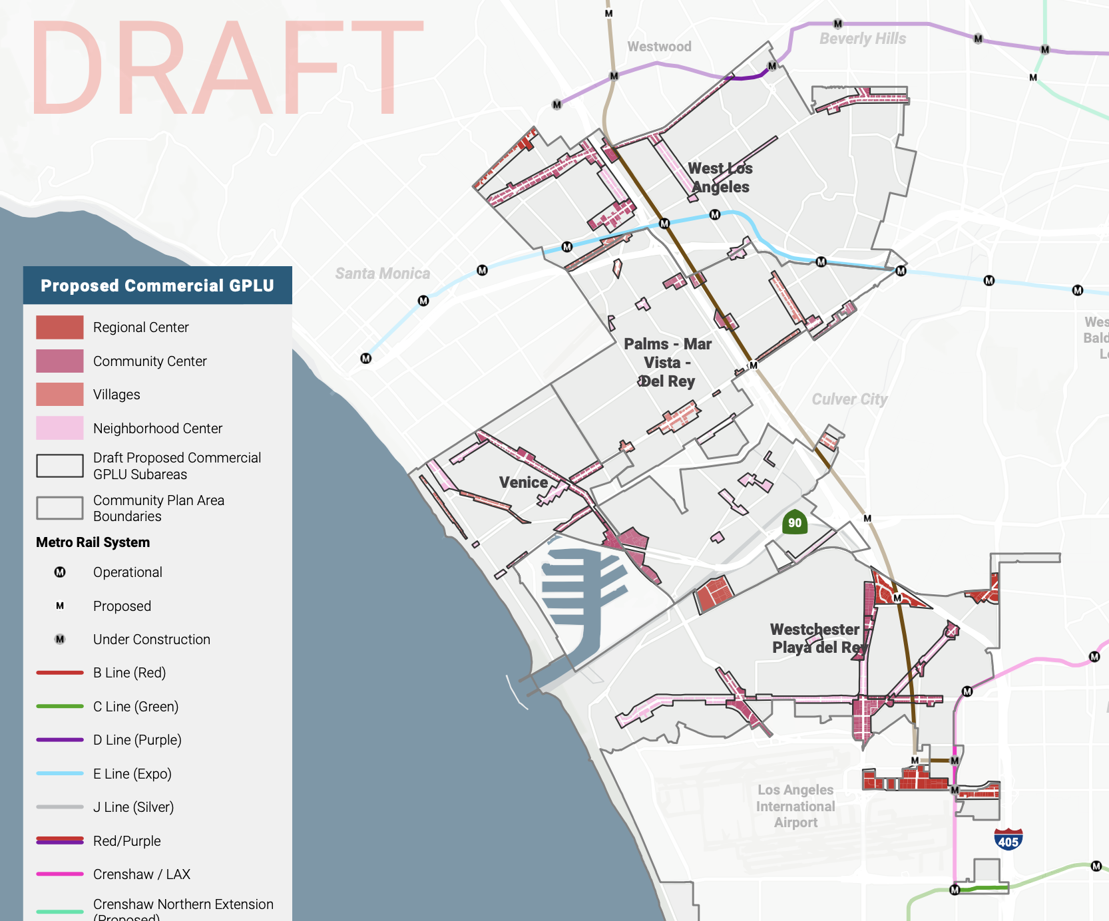
Context
Q for Planning: Why the density of Commercial Mixed-Use in Westchester Playa? Versus what’s shown for the other Westside Plans.
Answer:
The City’s overall strategy for greater housing density is Mixed-Use (1st floor retail, upper floors residential) Commercial on arterials. (It’s a general strategy)
Westchester Playa has under-developed arterials because so many parcels were not zoned Commercial. (In Westside, NCWP is the only community where arterials are lined by R1 parcels and not CZ parcels.)
Therefore, to push NCWP arterials to contribute density, proposal to convert of arterial R1 to Mixed-Use.

Slide 3
Response: Overall Commercial UpZoning Strategy to Increase Density on NCWP Arterials
Questions, Requests for Clarification: | Zoning change proposals you like:
Zoning change proposals you disagree with: | Alternative zoning proposals:

Slide 4
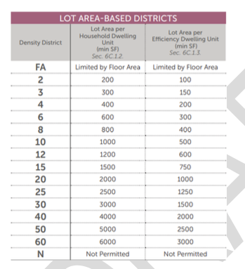
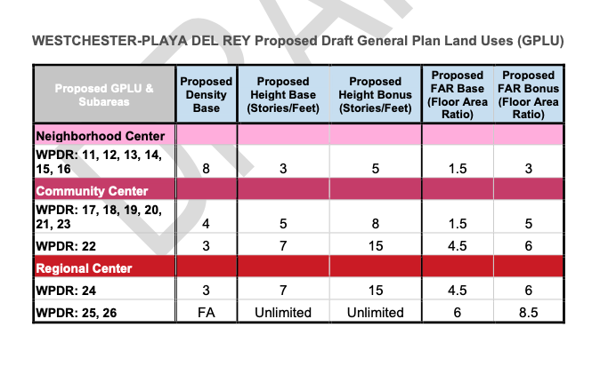
-
Planning indicates Density Base 3,4 and 8 in Draft 2 Commercial Maps.
What’s applied where.

Slide 5
Response: Zoning Base Categories Applied to Commercial
Questions, Requests for Clarification: | Zoning change proposals you like:
Zoning change proposals you disagree with: | Alternative zoning proposals:

Slide 6
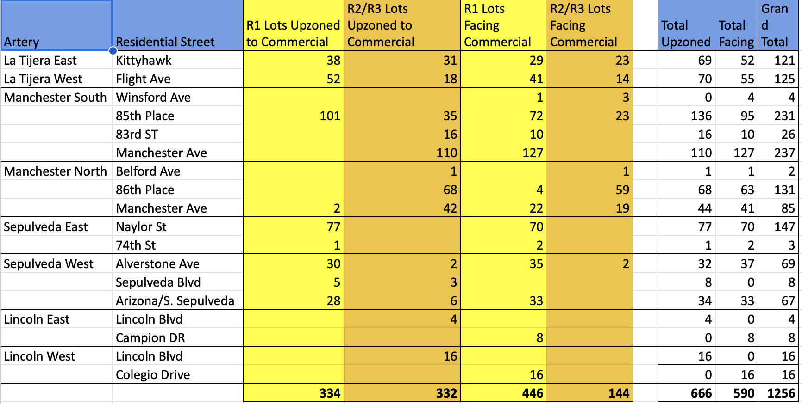
Commercial Map Audit of R-zoned Parcels Up-Zoned + Directly Adjacent
REALITY:
“Commercial” map adds another 666 “R” parcels being up-zoned for mixed use (which is primarily residential)
CONCERNS:
RSO units lost to up-zoning.
“Impact zone” for R-parcels adjacent to large format mixed use
Not a “missing middle” type approach
Arterials and LAX: studying other airports; so far, all have dedicated fwy exits. LAX does not.
Airport traffic flows must come into the discussion.

Slide 7
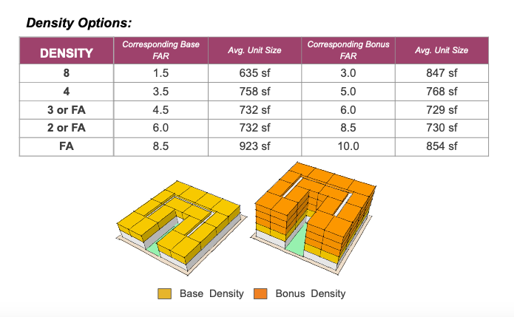
REFERENCE SHEET Building Specifications for Mixed-Use Density Zones in Draft 2 Maps (3, 4, 8 and FA)

Slide 8
Reference Chart: New Zoning Specs vs Current
Reference to help stakeholders compare what is now to what could be (new zoning)

Slide 9
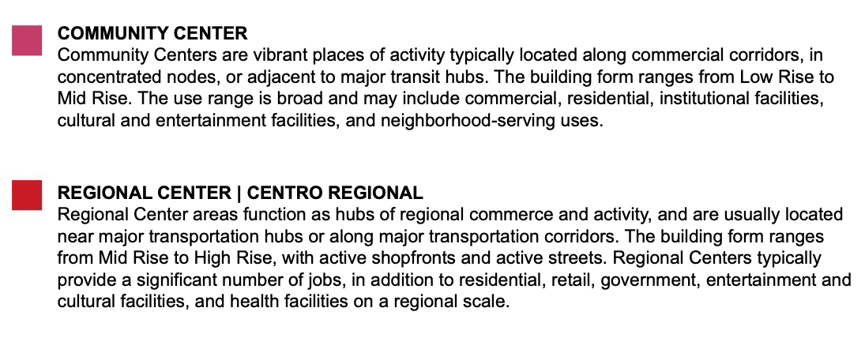
REFERENCE SHEET New Commercial GPLU Designations
Currently NCWP Draft 2 Commercial maps do not apply the “Village” profile to any areas. Possible negotiating point?

Slide 10
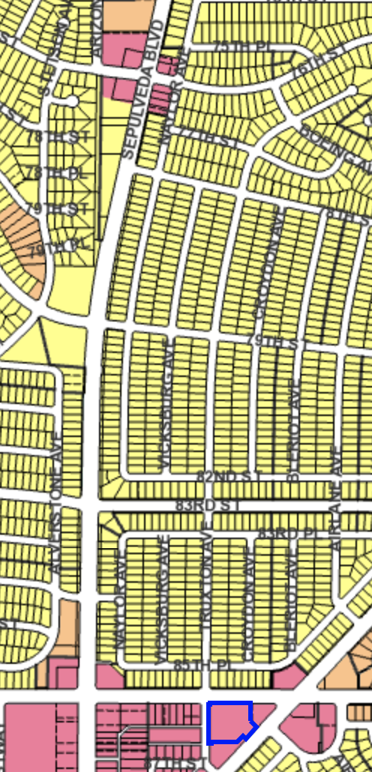
Reference points re R1 conversion to Mixed-Use Commercial
Planning’s Approach
First floor commercial facing arterial
But no new ingress/egress on arterial side
All ingress/egress happens on “back side” of building (interior, secondary residential street)
EXAMPLE:
Sepulveda Corridor Pt 1 of 3 / WPDR 13
This is why previous audit of R1 impacted by arterial up-zoning included BOTH actual up-zoned parcels and the R1 parcels immediately adjacent, facing the backs of mixed-use buildings fronting on an arterial.
Impacts:
Large built form
Excess traffic flows on secondary, residential roads

Slide 11
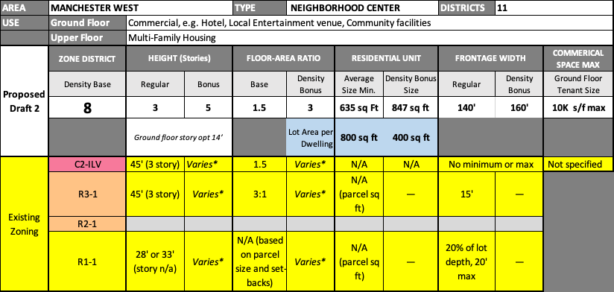
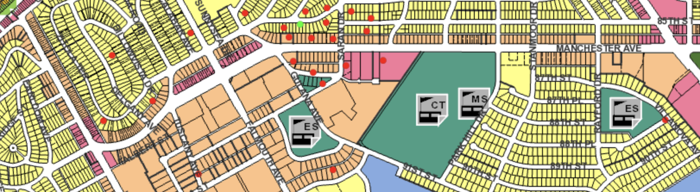
Manchester Ave West of Sepulveda / WPDR11
RSO-dense affordable housing area: preserve via overlay?
56
C2-ILV
178
R3-1
X
R2-1
2 lots
R1-1

Slide 12
Response: Manchester Ave West of Sepulveda / WPDR11
Questions, Requests for Clarification: | Zoning change proposals you like:
Zoning change proposals you disagree with: | Alternative zoning proposals:

Slide 13
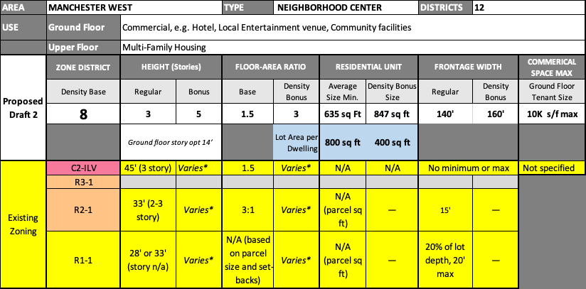
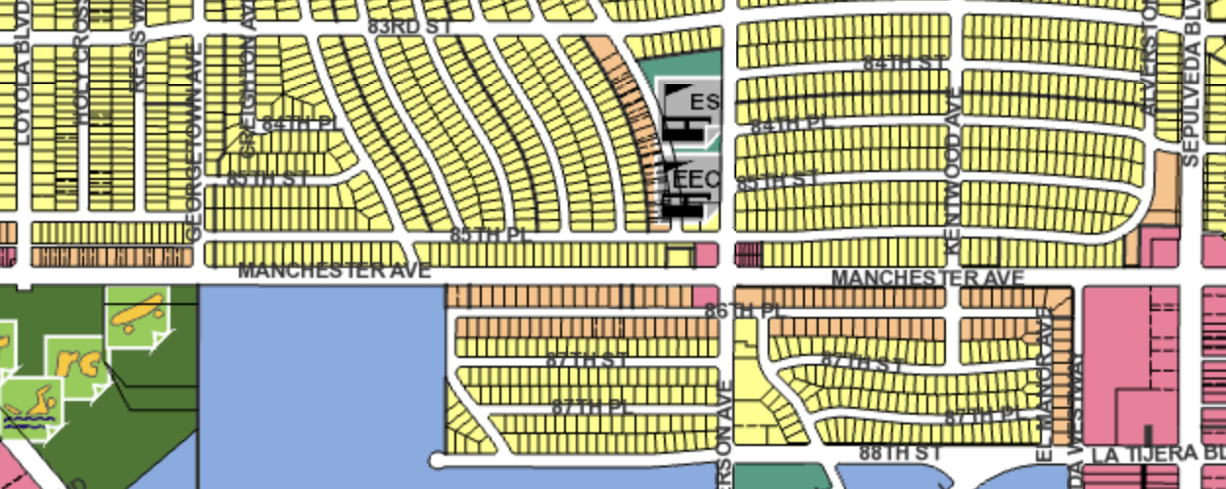
Manchester Ave West of Sepulveda / WPDR 12
R1 conversion
X
C2-ILV
X
R3-1
67
R2-1
68
R1-1

Slide 14
Response: Manchester Ave West of Sepulveda / WPDR 12
Questions, Requests for Clarification: | Zoning change proposals you like:
Zoning change proposals you disagree with: | Alternative zoning proposals:

Slide 15
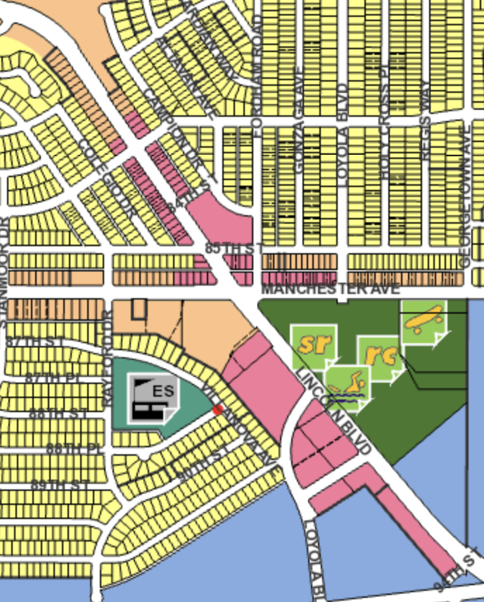
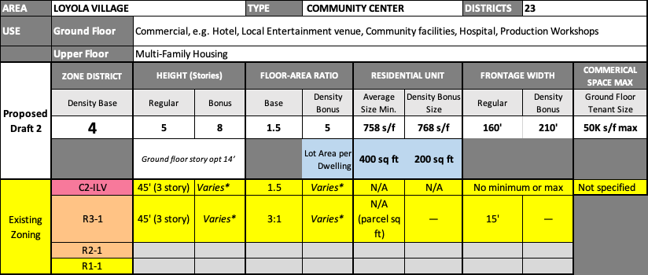
Loyola Village / Lincoln Only - WPDR 23
R1 Impacts
Campion & Cole Gio > have views today
Ends of Altavan, Fordham, Gonzaga – adjacent R3 parcels “missing middle” format?
Height Precedents @ Manchester & Lincoln
Playa Del Oro = 5 stories, 1st floor retail 14’
June Hotel = 12 stories, 1st floor. 14’
80
C2-ILV
27
R3-1
X
R2-1
X
R1-1

Slide 16
Response: Loyola Village / Lincoln Only - WPDR 23
Questions, Requests for Clarification: | Zoning change proposals you like:
Zoning change proposals you disagree with: | Alternative zoning proposals:

Slide 17
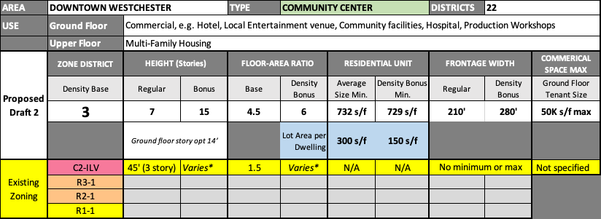
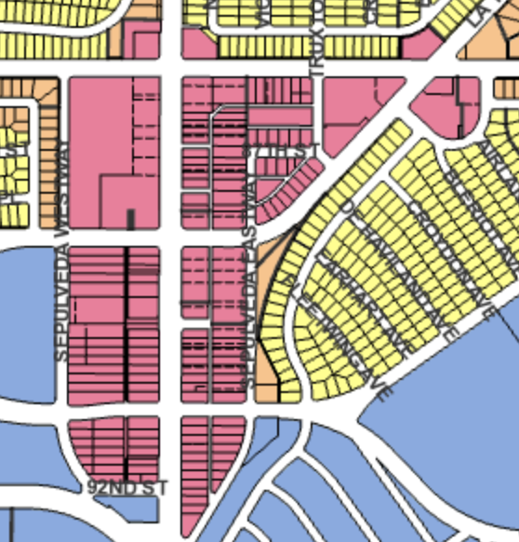
Westchester Downtown /WPDR 22
188
C2-ILV
X
R3-1
X
R2-1
X
R1-1

Slide 18
Response: Westchester Downtown /WPDR 22
Questions, Requests for Clarification: | Zoning change proposals you like:
Zoning change proposals you disagree with: | Alternative zoning proposals:

Slide 19
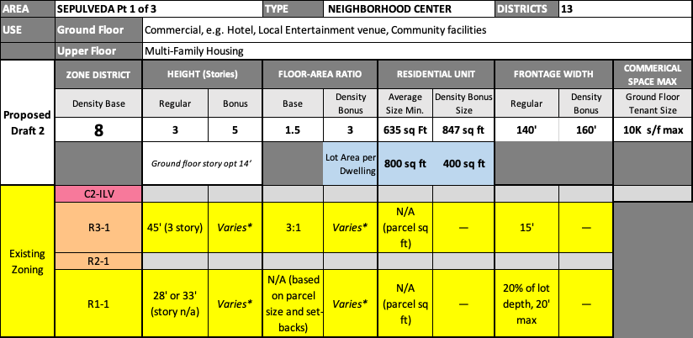
Sepulveda Corridor Pt 1 of 3 / WPDR 13
R1 conversion
X
C2-ILV
2
R3-1
X
R2-1
93
R1-1

Slide 20
Response: Sepulveda Corridor Pt 1 of 3 / WPDR 13
Questions, Requests for Clarification: | Zoning change proposals you like:
Zoning change proposals you disagree with: | Alternative zoning proposals:

Slide 21
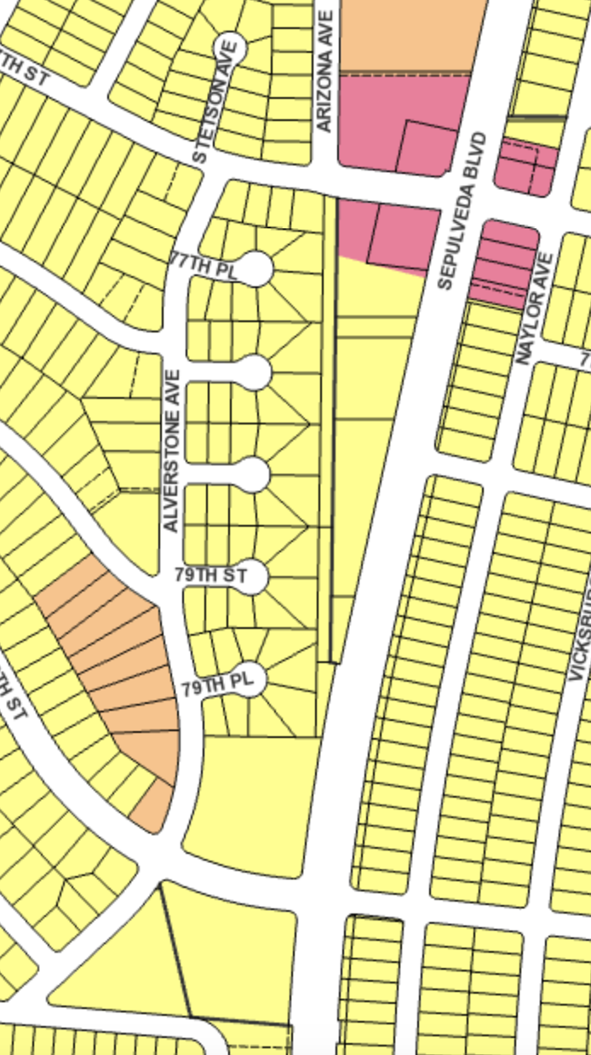
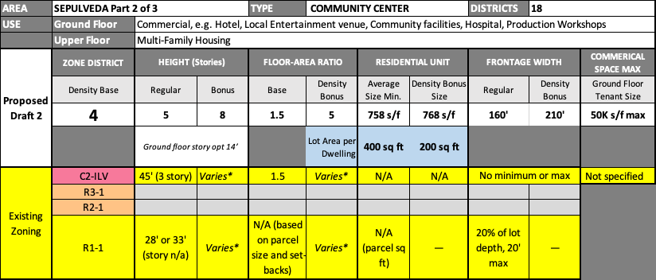
Sepulveda Corridor Pt 2 of 3 / WPDR 18
Armstrong Nursery
Mormon Church
Gas (diagonal corners)
Good Will
Westchester Lutheran (Church and School)
= Sepulveda curb cut
= access from interior street
Large parcels.
All being used in ‘commercial’ mode now
Churches: potential candidates for new state law re affordable housing
Orientation now: mostly not ingress/egress on Sepulveda
12
C2-ILV
Covenant Pres.
X
R3-1
X
R2-1
8
R1-1
YMCA

Slide 22
Response: Sepulveda Corridor Pt 2 of 3 / WPDR 18
Questions, Requests for Clarification: | Zoning change proposals you like:
Zoning change proposals you disagree with: | Alternative zoning proposals:

Slide 23
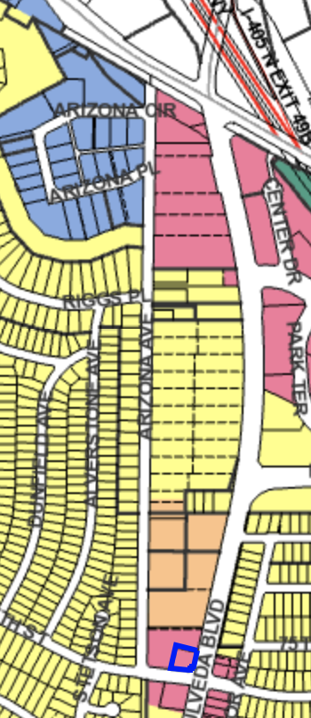
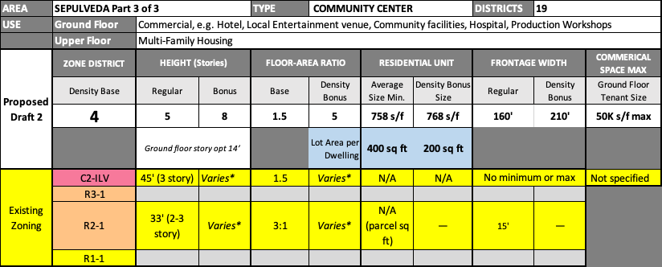
Sepulveda Corridor Pt 3 of 3 / WPDR 19 (slide 1 of 2)
Retail in entire R1 area isn’t actually Sepulveda ground level (it’s a hill)
Currently: private drive parallel to Sepulveda along R1’s on the hill. Doesn’t appear in Zimas map.
Also, view homes. ($$$ developer buy out…)
Mixed-Use designation seems off target in this R1 area.
R1 conversion on Sepulveda
Change ingress/egress orientation: unrealistic?
Building massing?
Downgrade to Density 8?
See next slide…
1
C2-ILV
6
R3-1
X
R2-1
27
R1-1

Slide 24
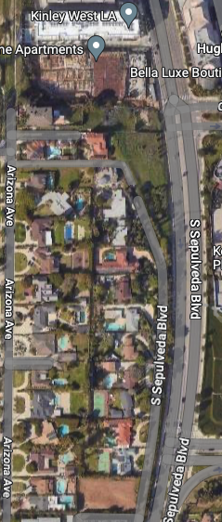
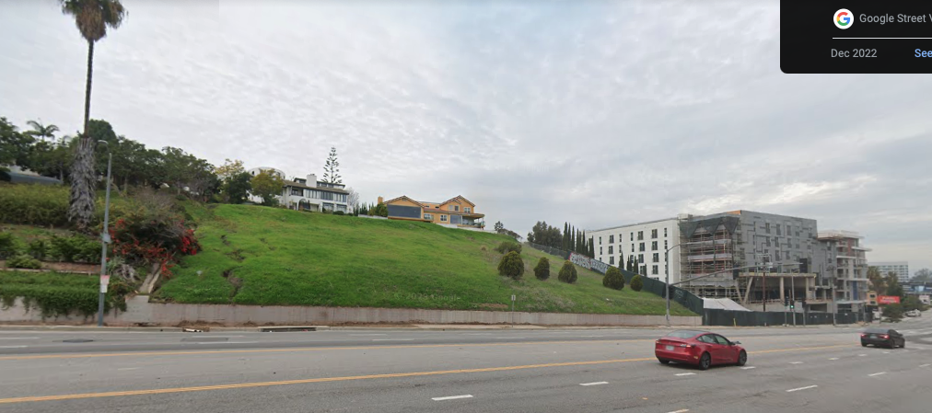
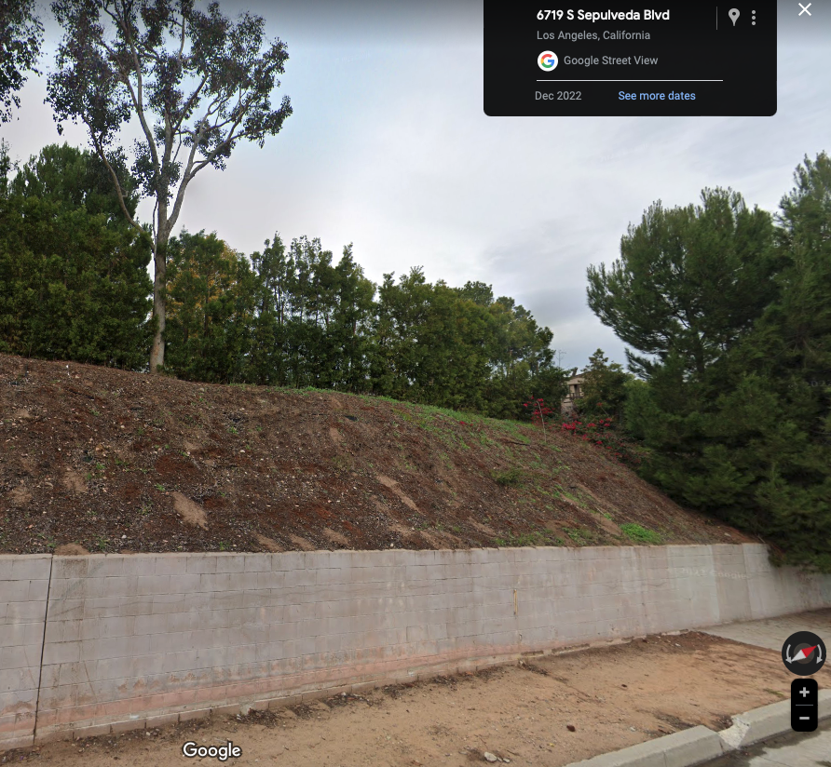
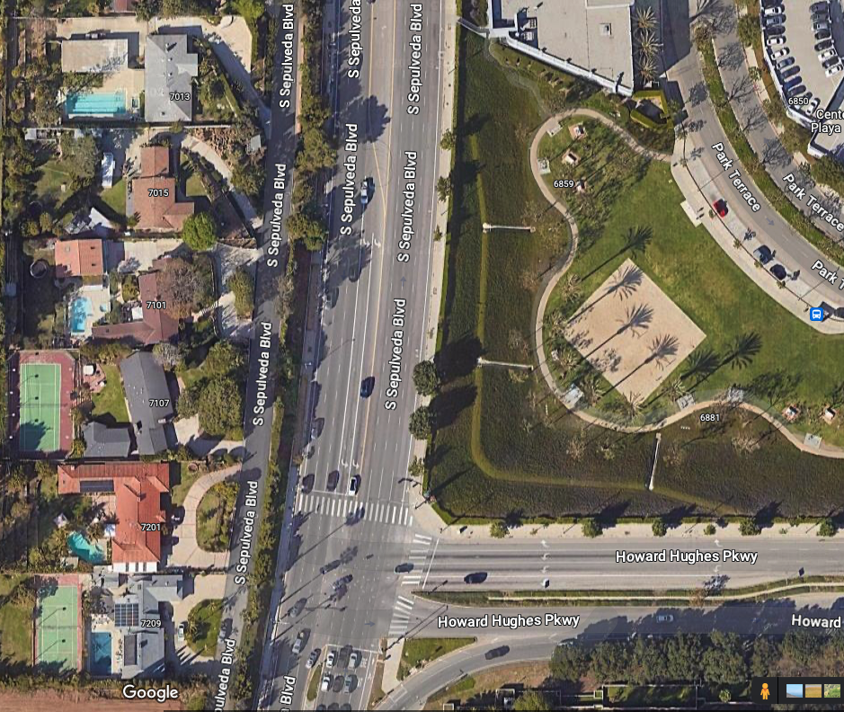
Sepulveda Corridor Pt 3 of 3 / WPDR 19 (slide 2 of 2)
Private Drive
Private Drive

Slide 25
Response: Sepulveda Corridor Pt 3 of 3 / WPDR 19
Questions, Requests for Clarification: | Zoning change proposals you like:
Zoning change proposals you disagree with: | Alternative zoning proposals:

Slide 26
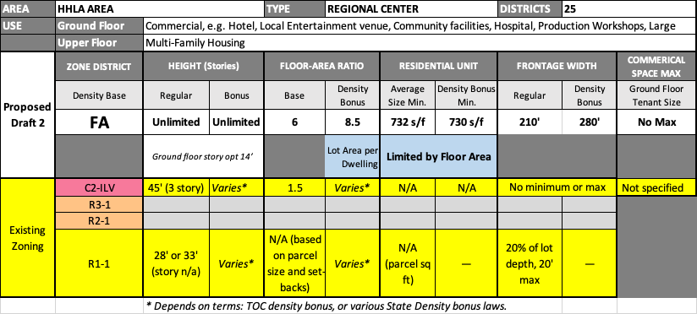
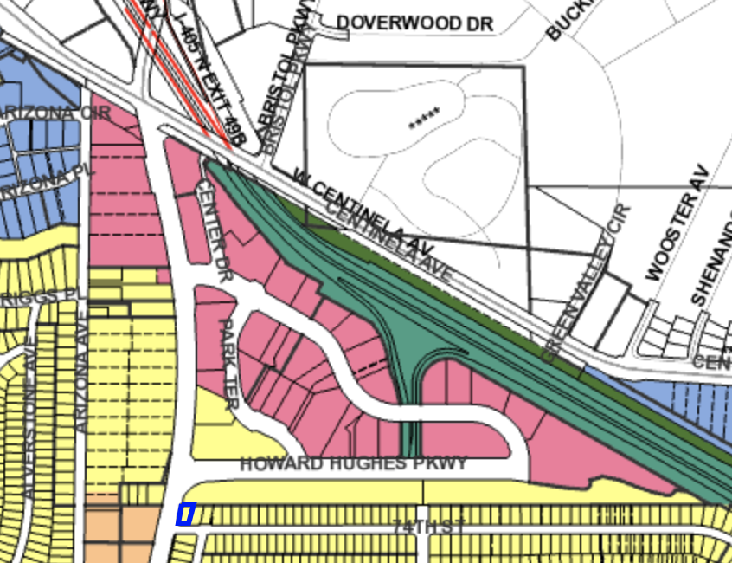
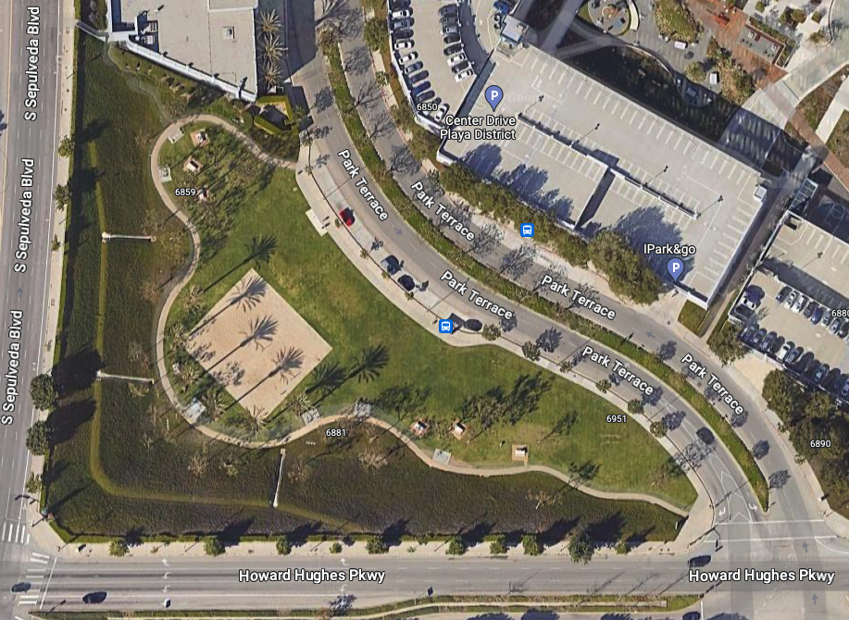
HHLA Area / WPDR 25
Currently: 2 larger R1 parcels
Green space with volleyball etc
Owned by commercial immediately adjacent?
Area already high density
Plannings take on FA and where that could
Precedent set by the right at corner of Sepulveda and Centinela.
Dinah’s project: 8 stories…well below FA potential
42
C2-ILV
R1 = open space amenity (private)
X
R3-1
X
R2-1
2
R1-1

Slide 27
Response: HHLA Area / WPDR 25
Questions, Requests for Clarification: | Zoning change proposals you like:
Zoning change proposals you disagree with: | Alternative zoning proposals:

Slide 28
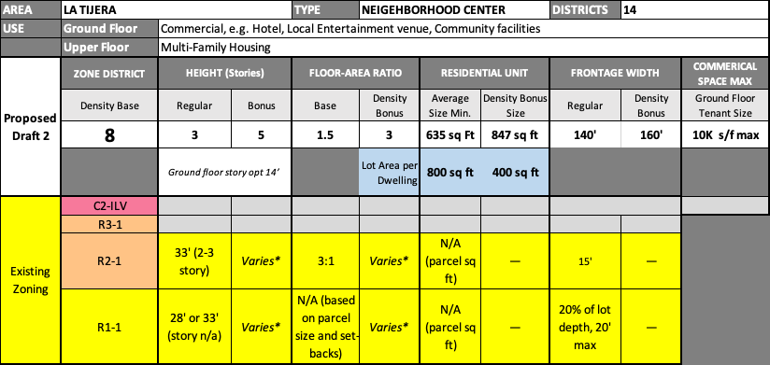
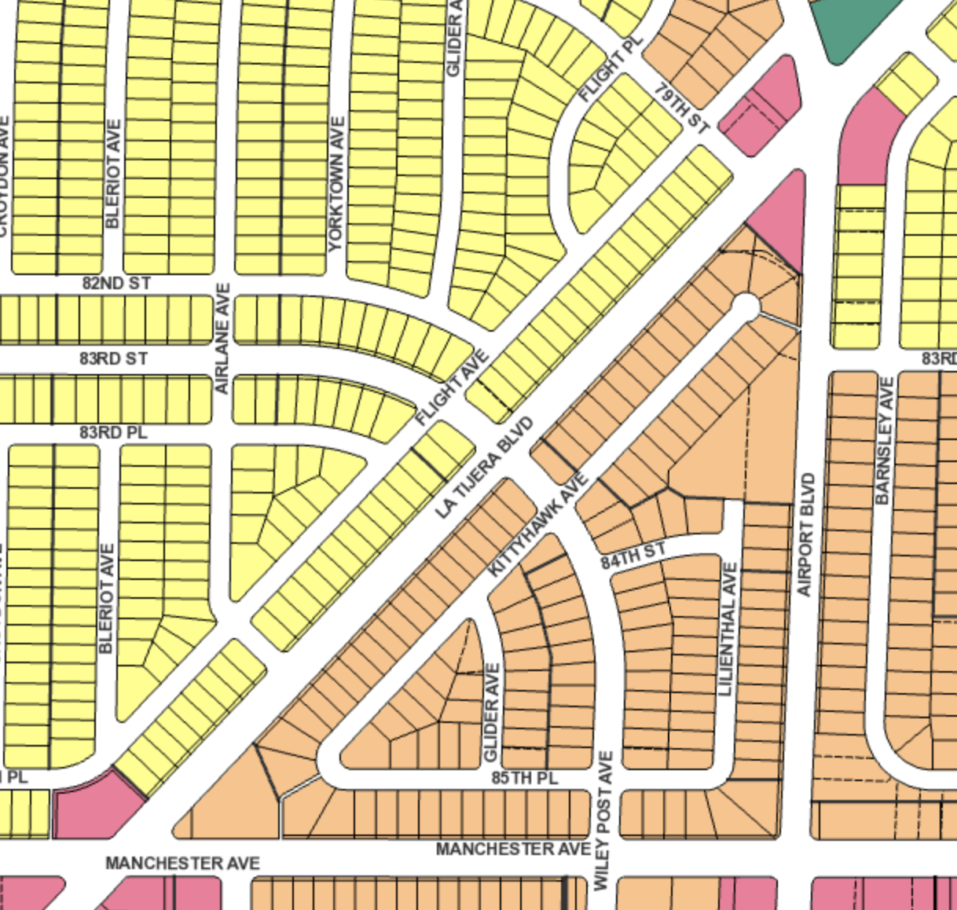
La Tijera / WPDR 14
R1 conversion
X
C2-ILV
X
R3-1
34
R2-1
41
R1-1

Slide 29
Response: La Tijera / WPDR 14
Questions, Requests for Clarification: | Zoning change proposals you like:
Zoning change proposals you disagree with: | Alternative zoning proposals:

Slide 30
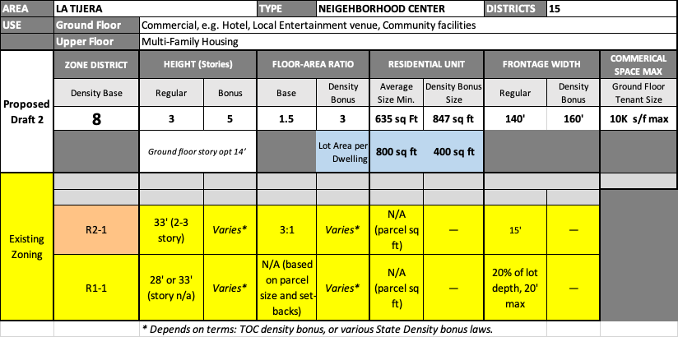
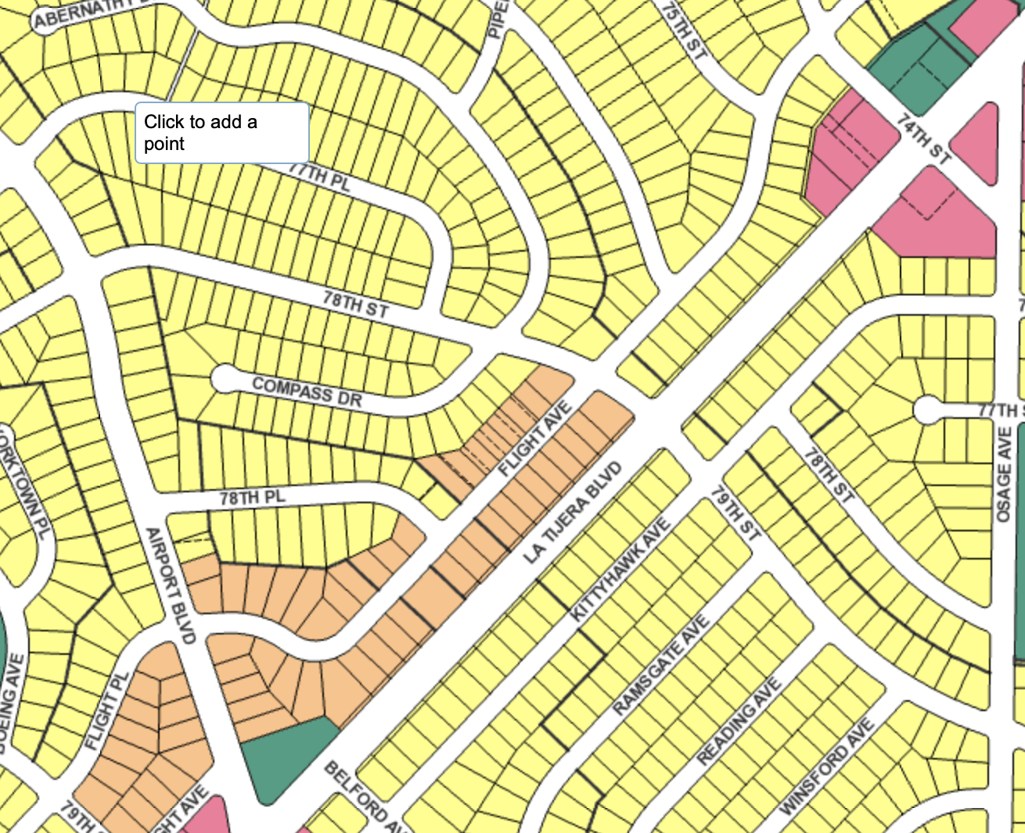
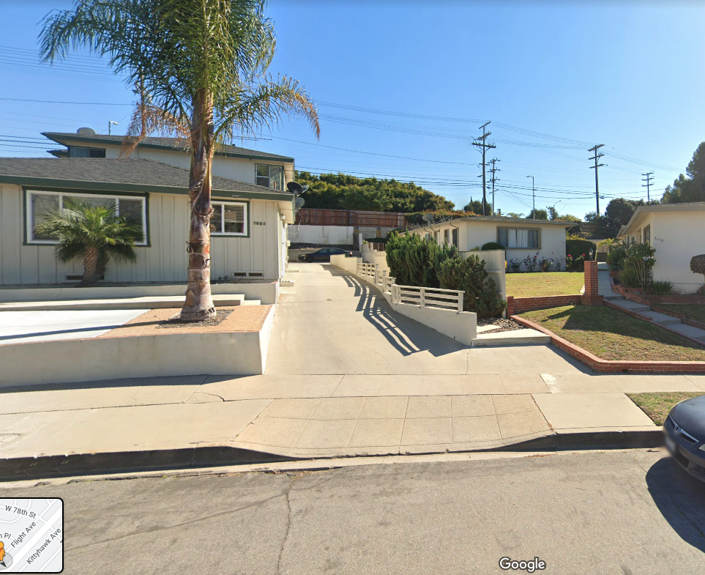
La Tijera / WPDR 15
R1 conversion
Topography difficult on Flight
Lots below La Tijera level
Big dip, lots at various levels relative to La Tijera
X
C2-ILV
X
R3-1
28
R2-1
55
R1-1

Slide 31
Response: La Tijera / WPDR 15
Questions, Requests for Clarification: | Zoning change proposals you like:
Zoning change proposals you disagree with: | Alternative zoning proposals:

Slide 32
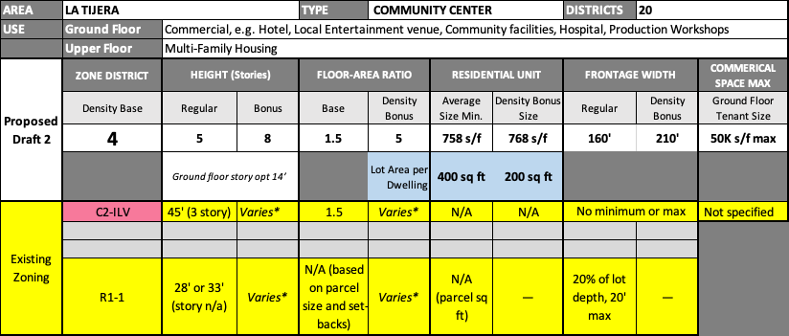
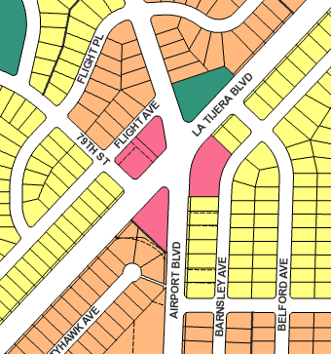
La Tijera / WPDR 20
Non-Profit Counseling Ctr
Carousel School (Special Needs)
Medical Bldg
Dry Cleaner & Easter Seals
Schools consideration
Carousel School - special needs
Westport Heights Elementary (2 blocks down on 79th)
Other Community-Serving Non-Profits
5
C2-ILV
X
R3-1
X
R2-1
9
R1-1

Slide 33
Response: La Tijera / WPDR 20
Questions, Requests for Clarification: | Zoning change proposals you like:
Zoning change proposals you disagree with: | Alternative zoning proposals:

Slide 34
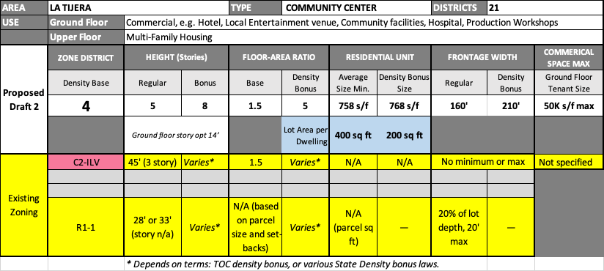
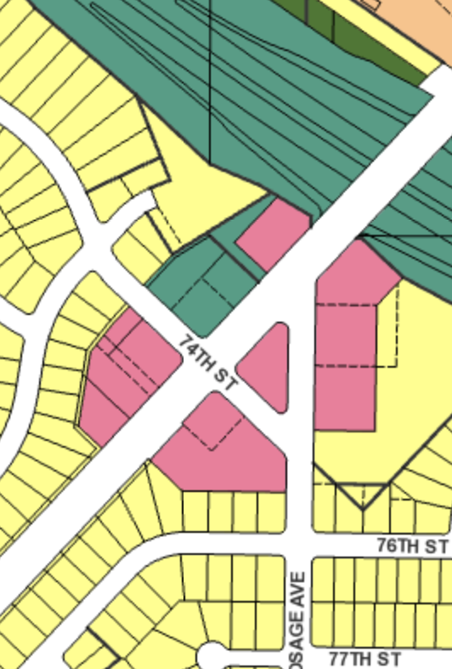
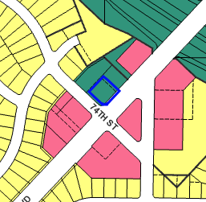
La Tijera / WPDR 21 (slide 1 of 2)
Post Office
Bodyshop
Gas + Wendy’s (LAX)
New: Density Proj Apts
New: Storage
Church
n/a
PF-1
9
C2-ILV
Gas+AM-PM (LAX)
X
R3-1
PF-1 associated with current Post Office (see details next slide)
X
R2-1
New: Memory Care (lo-rise)
Gas (LAX)
2
R1-1

Slide 35
PF-1 Zoning / WPDR 21 (slide 2 of 2)

Slide 36
Response: La Tijera / WPDR 21
Questions, Requests for Clarification: | Zoning change proposals you like:
Zoning change proposals you disagree with: | Alternative zoning proposals:

Slide 37
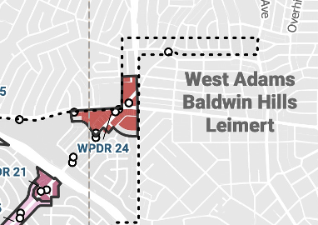
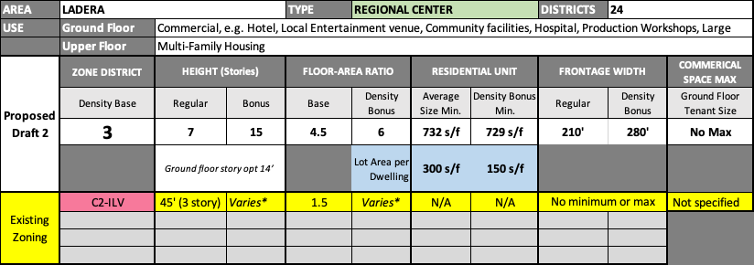
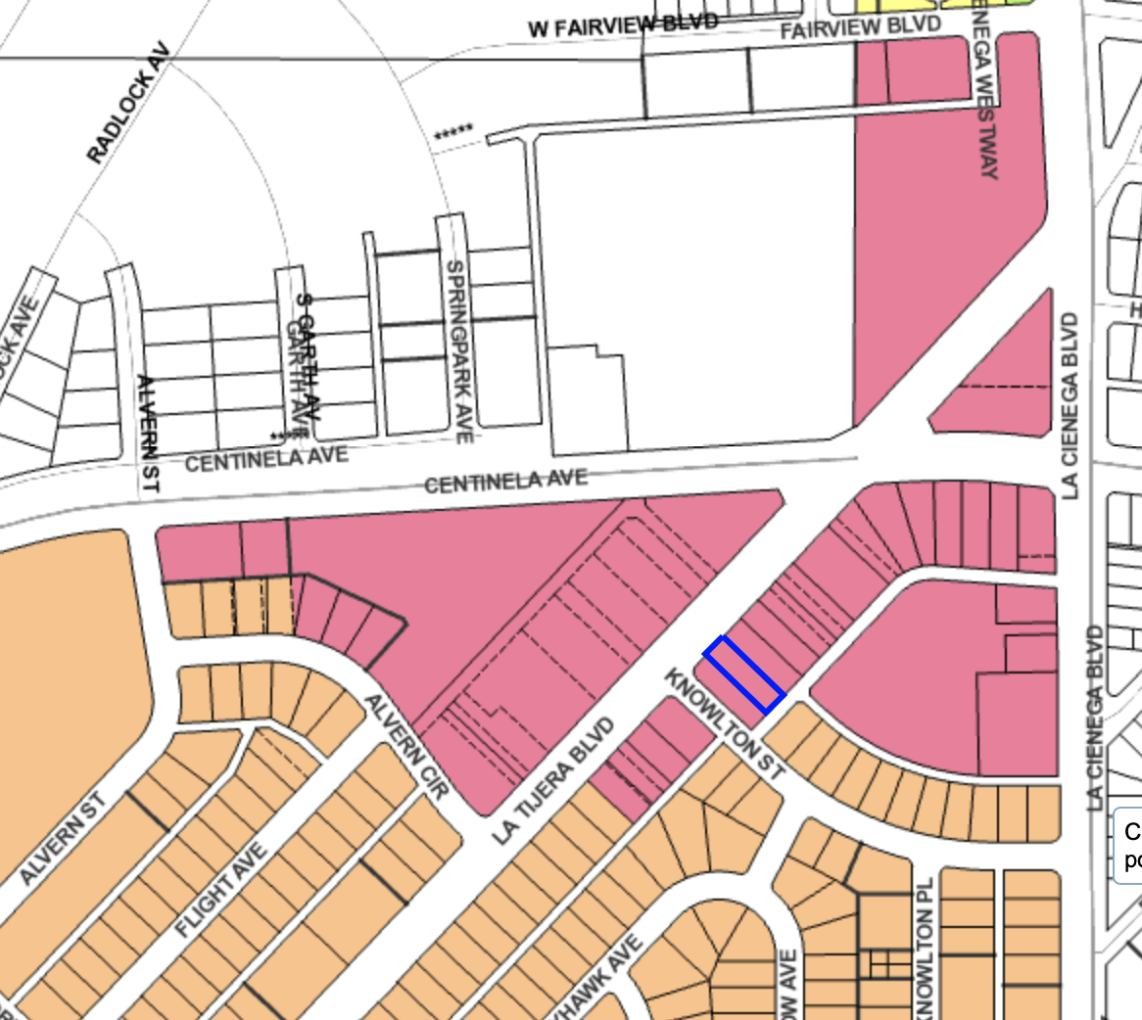
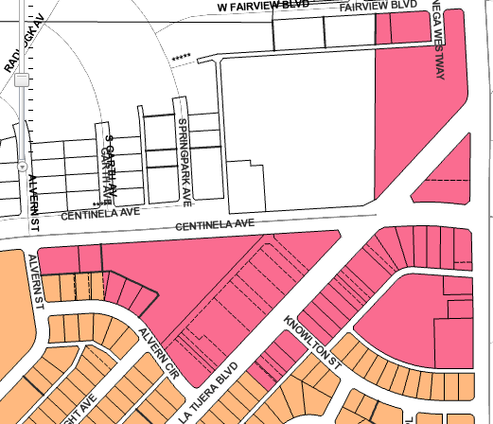
Ladera / WPDR 24
Large Strip Mall in 2 cities
Pann’s: Historic?
Characteristics now
Large strip mall – in 2 cities
Pann’s > Historic Designation?
C2 below Centinela: ok opportunity? (Goodwill, 99-Cent Store, etc)
Gas
19
C2-ILV
X
R3-1
X
R2-1
X
R1-1
McDonalds
New: Redevelopment

Slide 38
Response: Ladera / WPDR 24
Questions, Requests for Clarification: | Zoning change proposals you like:
Zoning change proposals you disagree with: | Alternative zoning proposals:

Slide 39
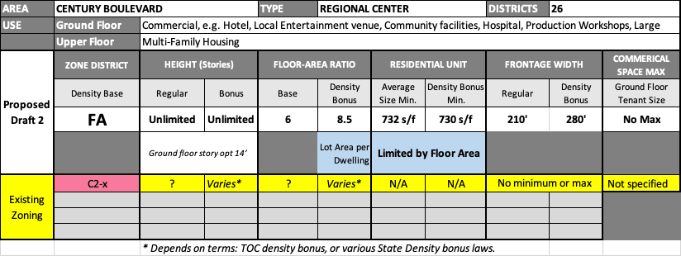
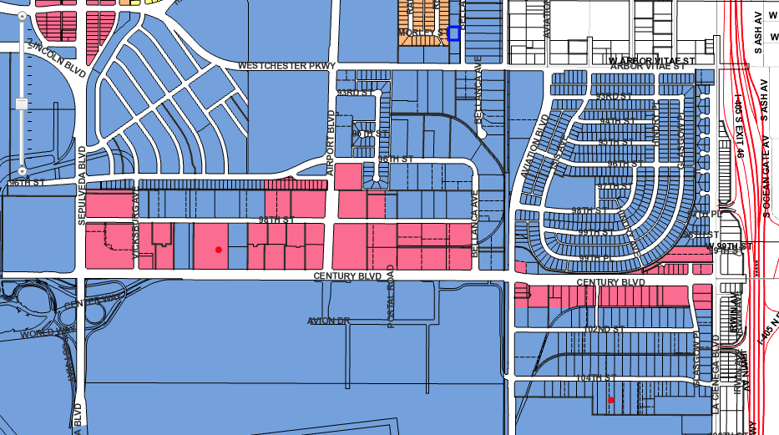
Century Boulevard / WPDR 26
Not all sections necessarily work as Mixed-Use
Some parcels = 100% high density residential?
?
33
C2
X
R3-1
X
R2-1
X
R1-1

Slide 40
Response: Century Boulevard / WPDR 26
Questions, Requests for Clarification: | Zoning change proposals you like:
Zoning change proposals you disagree with: | Alternative zoning proposals:

Slide 41
For further discussion: Are there other current COMMERCIAL locations in NCWP where you would propose Up-Zoning?
Where?
Why?
What Zone Density Base would you recommend? (See page 7 of this workbook for table of possible Density Base choices.)
Copy this page and make as many as you have suggestions for

Slide 42
RECAP: Notes on Commercial Draft 2 Map

