Slide 1
Westchester-Playa CPU DRAFT 2 MAPS
STAKEHOLDER RESPONSE TO PLANNERS WORKBOOK RESIDENTIAL MAP STUDY
Prepared by Kimberly Fox, Cory Birkett
Community Stakeholders

Slide 2
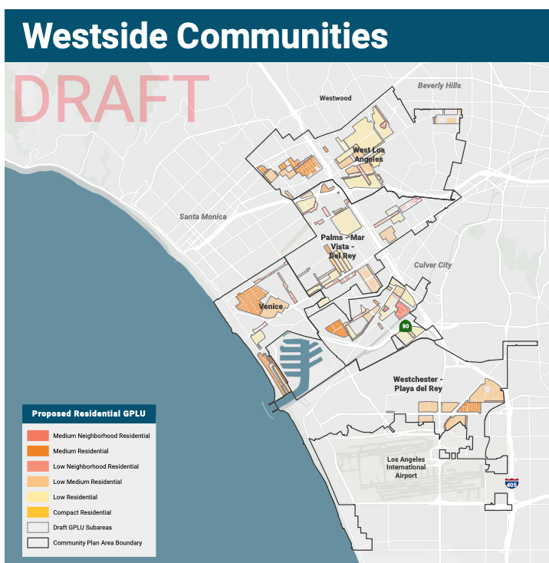
Context
NCWP’s Community Plan is being created in parallel (at the same time) as new Community Plan Updates for
Venice
West LA
Palms-Mar Vista-Del Rey
(NCWP)
This map shows the RESIDENTIAL plan for all 4 Westside CPU groups.

Slide 3
Response: NCWP Residential Up Zoning vs other Westside Plan Areas
Questions, Requests for Clarification: | Zoning change proposals you like:
Zoning change proposals you disagree with: | Alternative zoning proposals:

Slide 4
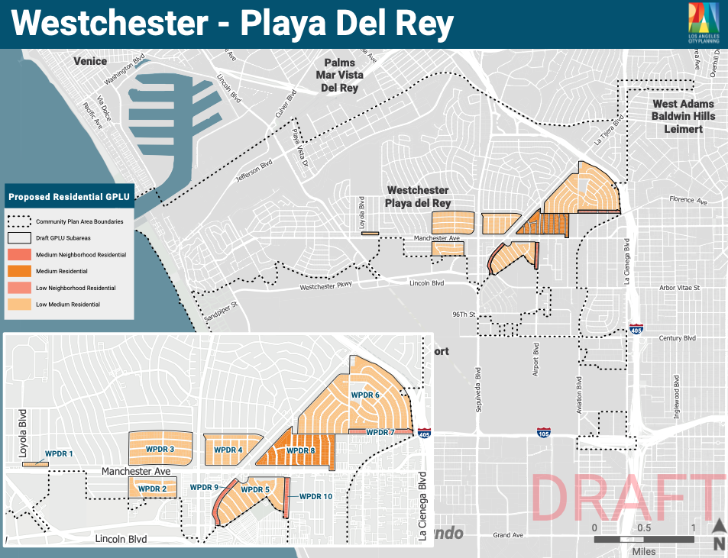
What’s applied where.

Slide 5
Response: General area selections for R1 Up Zoning
Questions, Requests for Clarification: | Zoning change proposals you like:
Zoning change proposals you disagree with: | Alternative zoning proposals:

Slide 6
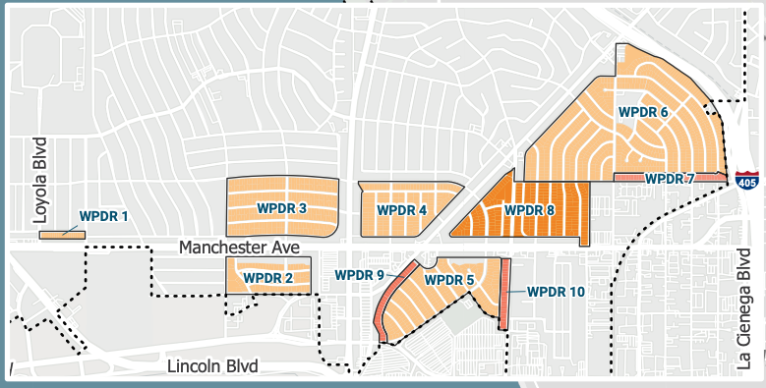
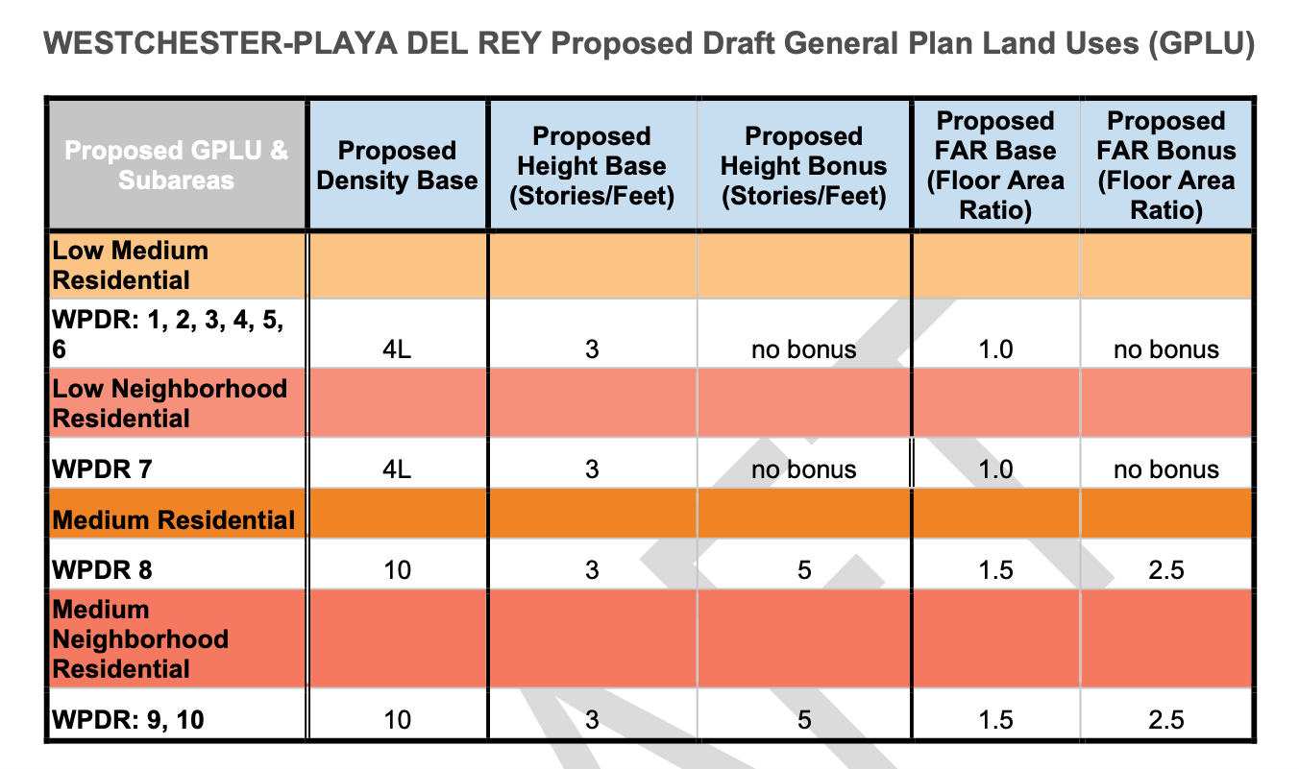
Residential New Density Zones: 4L and 10
Planning indicates two residential up-zoning categories:
Density Base 4L - defines maximum # of units per lot regardless of parcel sq footage.
Density Base 10 – defines maximum # of units per lot by dividing parcel sq footage by minimum dwelling size.

Slide 7
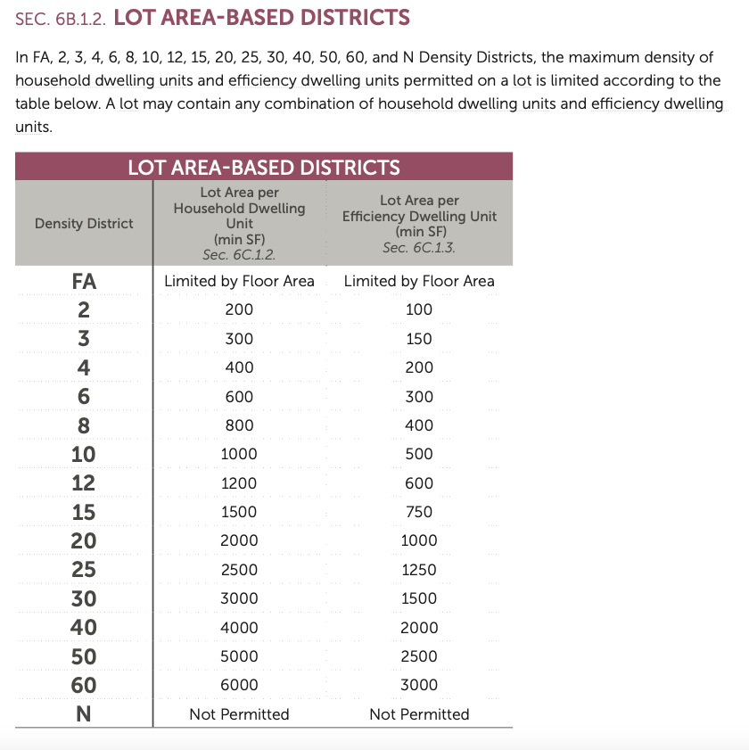
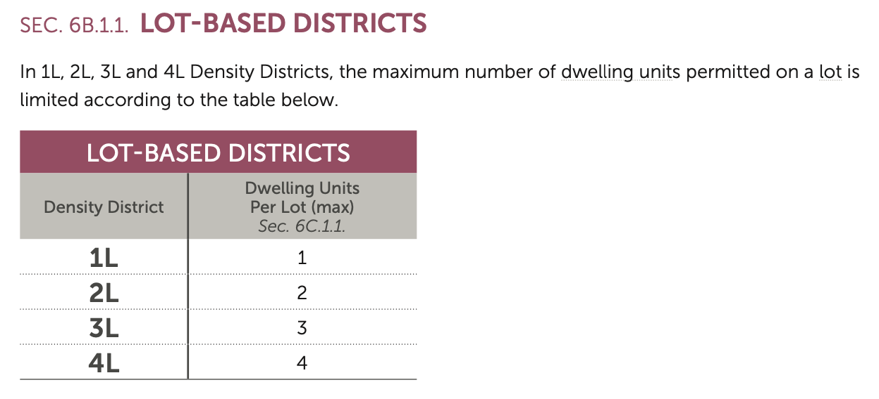
Metrics for Determining # New Units Allowable per Density Zone
Note. There are 6 Density Zone categories (FA through 8) more dense than what’s proposed for NCWP.
And 8 Density Zone categories (12-60) less dense than what’s proposed for NCWP.
https://planning.lacity.org/odocument/b0c5f347-b375-445e-b363-3502d3714ce7/recodeLA_Art06-Density_DT_CPC_Recommendation_Draft_Sept2022.pdf

Slide 8
Response: Recommendation of Residential Density Zones 4L and 10 Only
Questions, Requests for Clarification: | Zoning change proposals you like:
Zoning change proposals you disagree with: | Alternative zoning proposals:

Slide 9
Density Base 4L Zone Recap
4L = 4 Dwelling Units per Lot

Slide 10
Response: Density Base 4L Zone Overview
Questions, Requests for Clarification: | Zoning change proposals you like:
Zoning change proposals you disagree with: | Alternative zoning proposals:

Slide 11
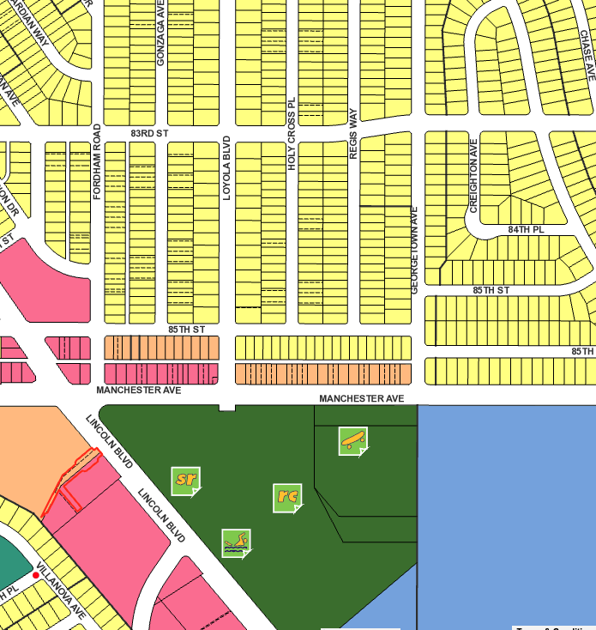
Density Base 4L Zone / WPDR 1
4L = 4 Dwelling Units per Lot
20 | R1-1
17 | R3-1

Slide 12
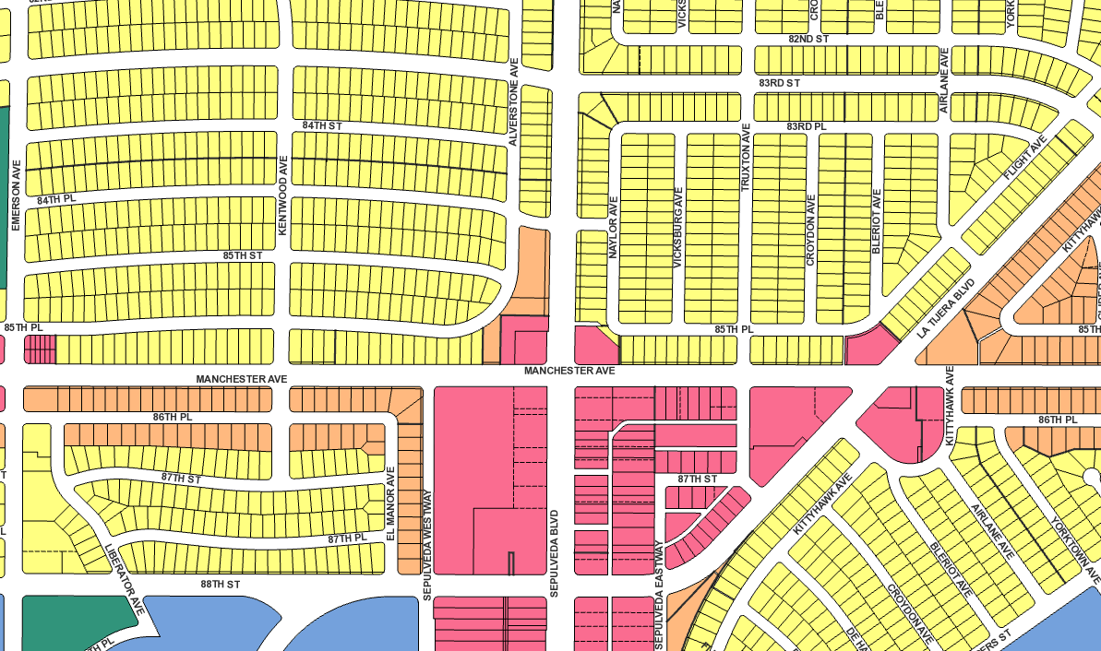
Density Base 4L Zone / WDPR 2, 3, 4
4L = 4 Dwelling Units per Lot
328 | R1-1
X | R3-1
207 | R1-1
X | R3-1
99 | R1-1
X | R3-1

Slide 13
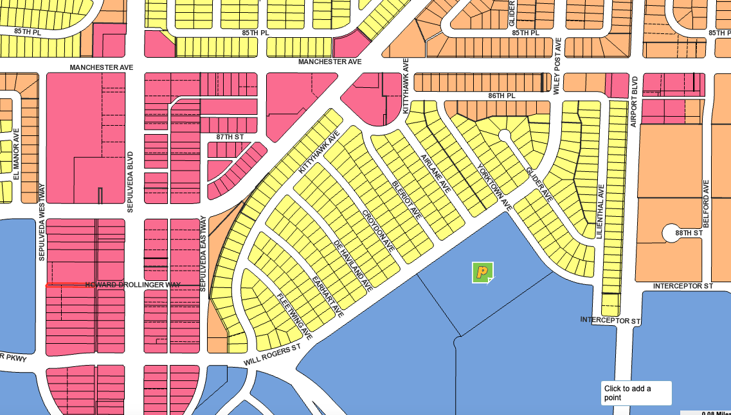
Density Base 4L Zone / WPDR 5
4L = 4 Dwelling Units per Lot
260 | R1-1
X | R3-1

Slide 14
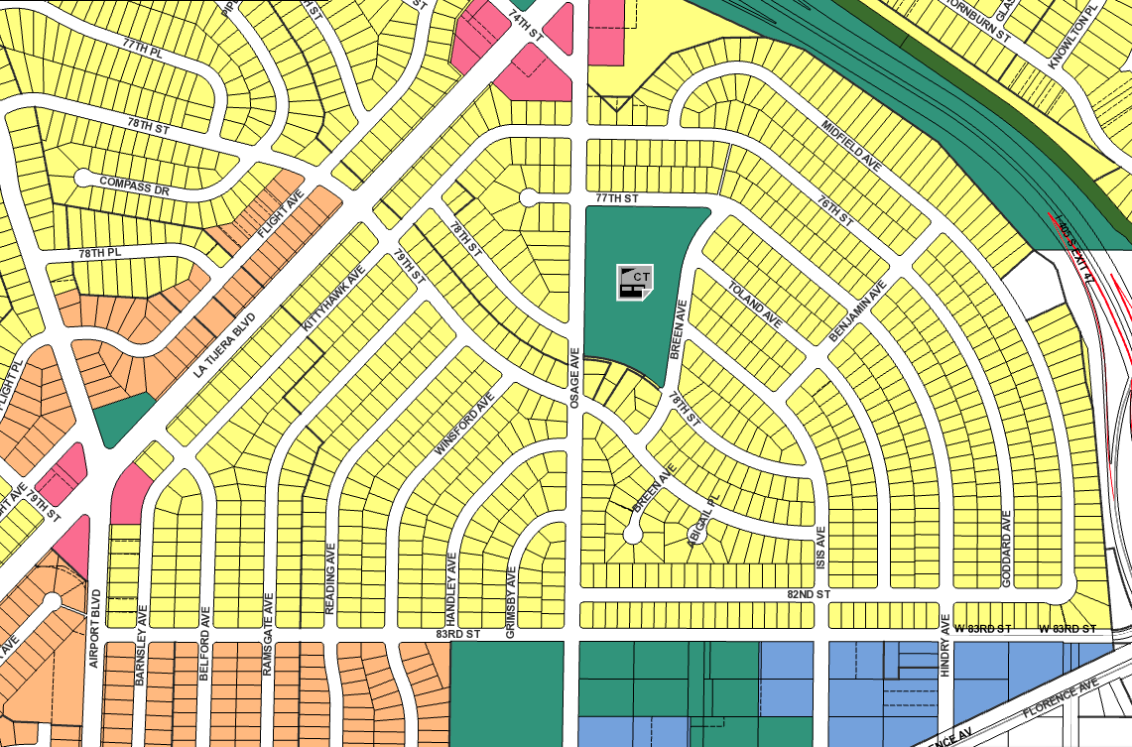
Density Base 4L Zone / WPDR 6
4L = 4 Dwelling Units per Lot
803 | R1-1
X | R3-1

Slide 15
Density Base 10 Zone Recap
10 = 1 Regular living unit per 1000 sq ft of parcel OR
1 Efficiency living unit per 500 sq ft of lot

Slide 16
Response: Density Base 10 Zone Overview
Questions, Requests for Clarification: | Zoning change proposals you like:
Zoning change proposals you disagree with: | Alternative zoning proposals:

Slide 17
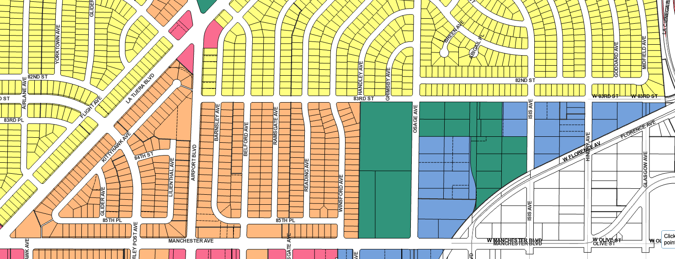
Density Base 10 Zone / WPDR 7, 8
10 = 1 Regular living unit per 1000 sq ft of parcel OR
1 Efficiency living unit per 500 sq ft of lot
38 | R1-1
X | R2-1
X | R3-1
X | R1-1
281 | R2-1
X | R3-1

Slide 18
Response: Density Base 10 Zone / WPDR 7, 8
Questions, Requests for Clarification: | Zoning change proposals you like:
Zoning change proposals you disagree with: | Alternative zoning proposals:

Slide 19
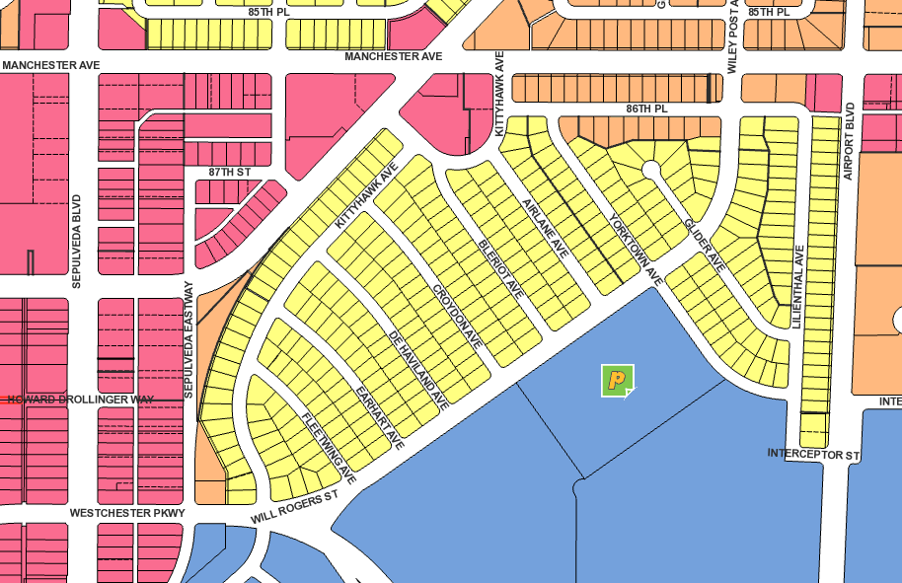
Density Base 10 Zone / WPDR 9, 10
10 = 1 Regular living unit per 1000 sq ft of parcel OR
1 Efficiency living unit per 500 sq ft of lot
27 | R1-1
X | R2-1
X | R3-1
30 | R1-1
X | R2-1
X | R3-1

Slide 20
Response: Density Base 10 Zone / WPDR 9, 10
Questions, Requests for Clarification: | Zoning change proposals you like:
Zoning change proposals you disagree with: | Alternative zoning proposals:

Slide 21
For further discussion: Are there other current RESIDENTIAL locations in NCWP where you would propose Up-Zoning?
Where?
Why?
What Zone Density Base would you recommend? (See page 7 of this workbook for table of possible Density Base choices.)
Copy this page and make as many as you have suggestions for

Slide 22
RECAP: Notes on Residential Draft 2 Map

