Slide 1
Westchester-Playa CPU DRAFT 2 MAPS
STAKEHOLDER PLANNING RESPONSE WORKBOOK INDUSTRIAL MAP STUDY
Prepared by Kimberly Fox, Cory Birkett
Community Stakeholders

Slide 2
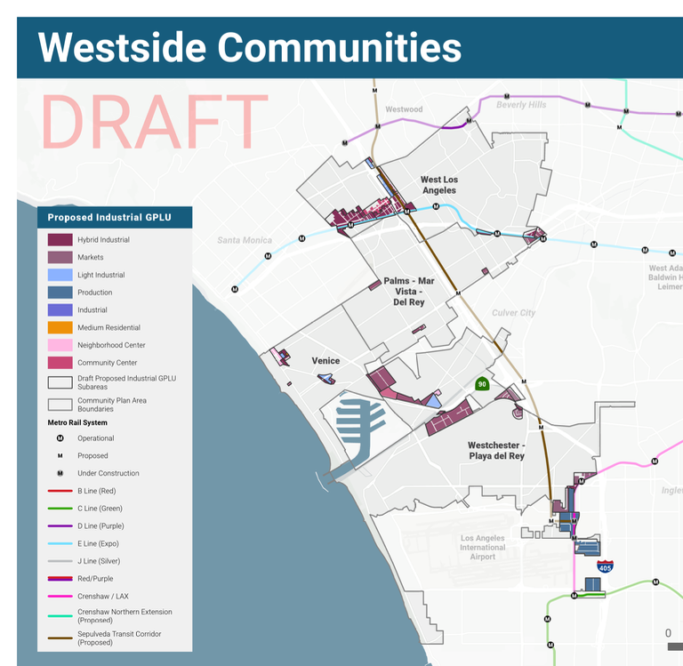
Context
NCWP’s Community Plan is being created in parallel (at the same time) as new Community Plan Updates for
Venice
West LA
Palms-Mar Vista-Del Rey
(NCWP)
This map shows the INDUSTRIAL plan for all 4 Westside CPU groups.

Slide 3
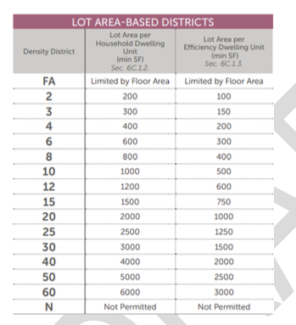
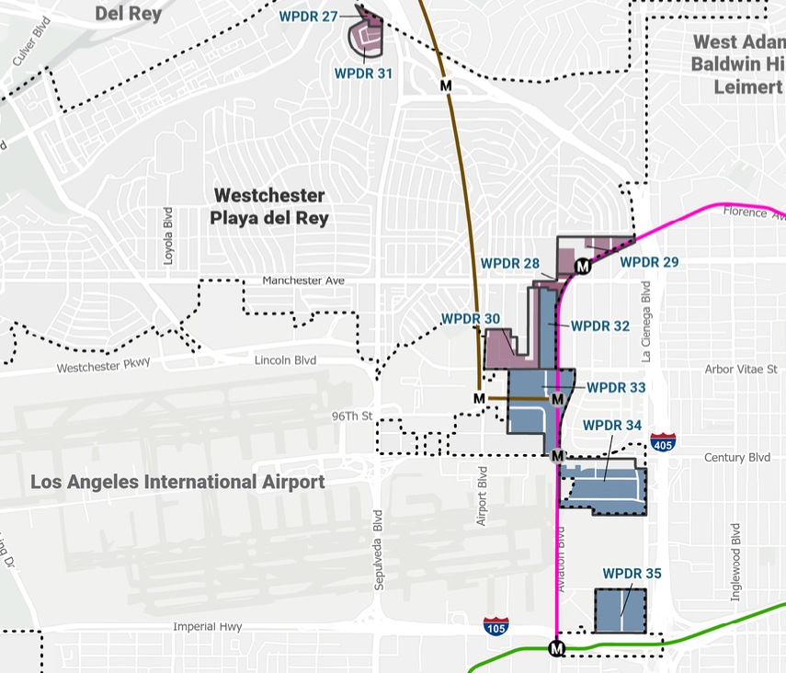
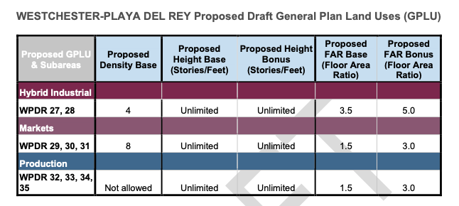
-
Planning indicates Density Base 4 and 8 in Draft 2 Industrial Maps. Translates into built form that (among other things) can include live-work housing.

Slide 4
Built Form Overview / Zoning Changes in Draft 2 Maps
31 = Density Base 8
27 = Density Base 4
28 = Density Base 4
29 = Density Base 8
30 = Density Base 8
Re area 30, GPLU chart indicates Base 8 Density. But Illustration of built form (see slide for area 30) indicates industrial use.
32,33,34,35 (red area) Use restricted to Industrial Only

Slide 5
Response: Built Form Overview / Zoning Changes in Draft 2 Maps
Questions, Requests for Clarification: | Zoning change proposals you like:
Zoning change proposals you disagree with: | Alternative zoning proposals:

Slide 6
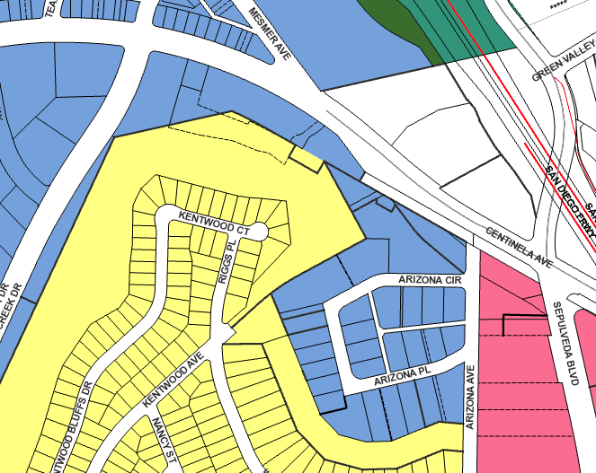
Arizona Circle Area / WPDR 27
Notes?
X | [T][Q] M1-1
5 | [Q] ML1-LV
X | MR1-1
X | MR 2-1
X | PF-1

Slide 7
Response: Arizona Circle Area / WPDR 27
Questions, Requests for Clarification: | Zoning change proposals you like:
Zoning change proposals you disagree with: | Alternative zoning proposals:

Slide 8
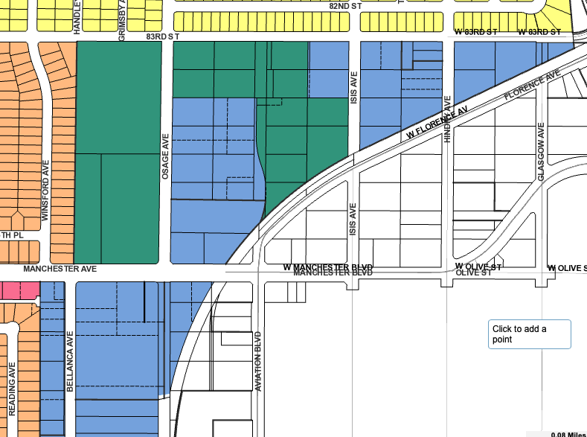
Metro-Veterans Area / WPDR 28
Notes?
X | [T][Q] M1-1
X | [Q] ML1-1 or ML1-LV (5)
4? | MR1-1
15 | MR 2-1
n/a | PF-1

Slide 9
Response: Metro-Veterans Area / WPDR 28
Questions, Requests for Clarification: | Zoning change proposals you like:
Zoning change proposals you disagree with: | Alternative zoning proposals:

Slide 10
Metro-Veterans / WPDR 29
X | [T][Q] M1-1
X | [Q] ML1-1 or ML1-LV (5)
X | MR1-1
31 | MR 2-1
14 | PF-1 (zoning doesn’t change)

Slide 11
Response: Metro-Veterans / WPDR 29
Questions, Requests for Clarification: | Zoning change proposals you like:
Zoning change proposals you disagree with: | Alternative zoning proposals:

Slide 12
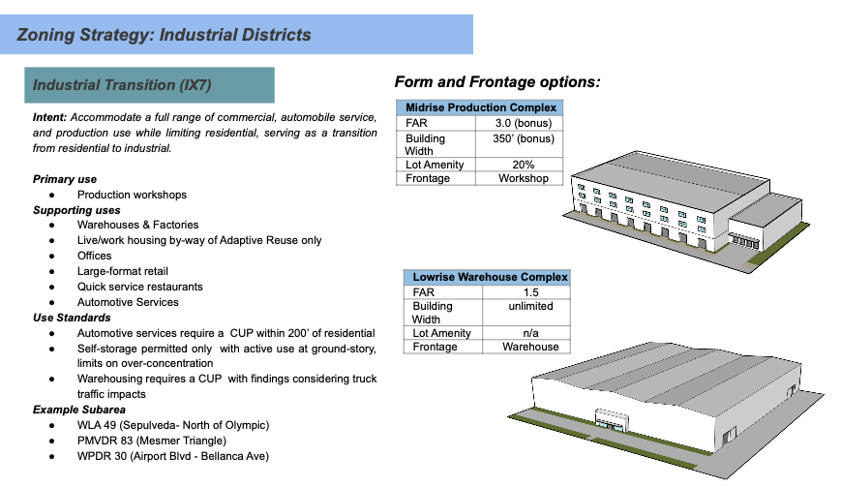
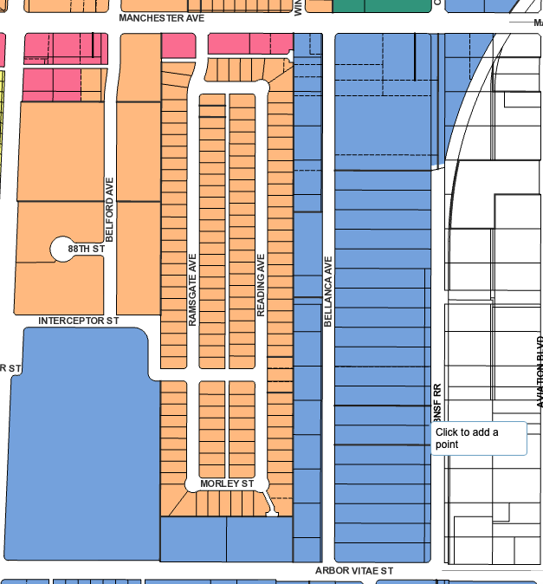
Manchester-Arbor Vitae Area / WPDR 30
1 | [T][Q] M1-1
X | [Q] ML1-1 or ML1-LV (5)
24 | MR1-1
X | MR 2-1
X | PF-1

Slide 13
Response: Manchester-Arbor Vitae Area / WPDR 30
Questions, Requests for Clarification: | Zoning change proposals you like:
Zoning change proposals you disagree with: | Alternative zoning proposals:

Slide 14
Arizona Circle Area / WPDR 31
X | [T][Q] M1-1
27 | [Q] ML1-LV
X | MR1-1
X | MR 2-1
X | PF-1

Slide 15
Response: Arizona Circle Area / WPDR 31
Questions, Requests for Clarification: | Zoning change proposals you like:
Zoning change proposals you disagree with: | Alternative zoning proposals:

Slide 16
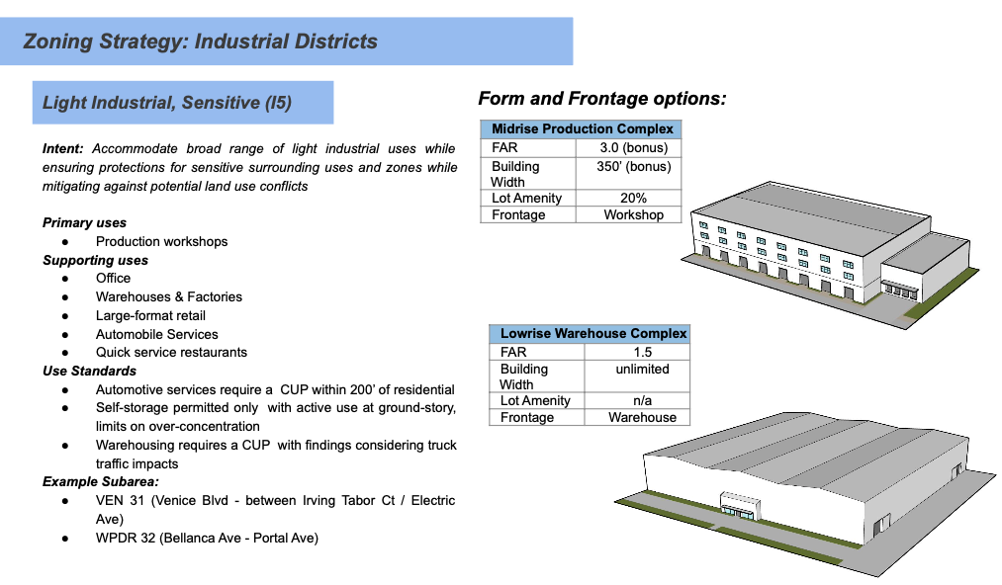
Manchester-Arbor Vitae Area / WPDR 32
Notes?
X | [T][Q] M1-1
X | [Q] ML1-1 or ML1-LV (5)
X | MR1-1
24 | MR 2-1
X | PF-1

Slide 17
Response: Manchester-Arbor Vitae Area / WPDR 32
Questions, Requests for Clarification: | Zoning change proposals you like:
Zoning change proposals you disagree with: | Alternative zoning proposals:

Slide 18
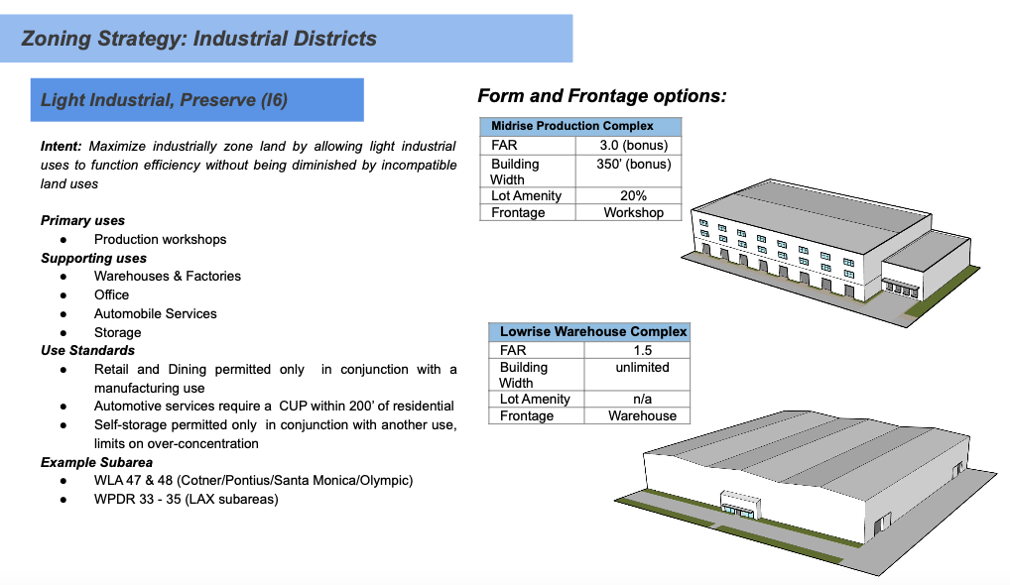
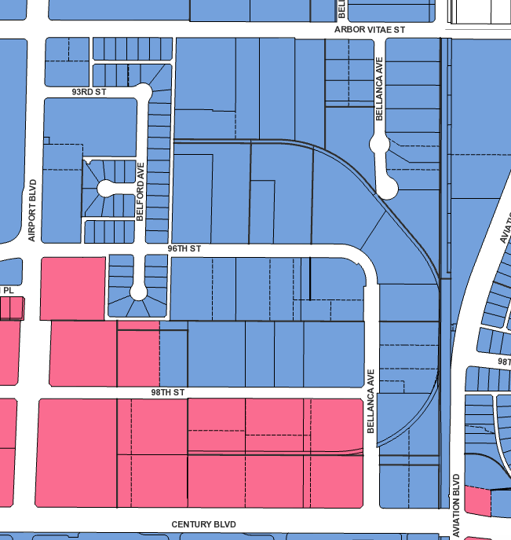
South of Arbor Vitae / WPDR 33
Notes?
This means all three districts: 33, 34 and 35.
X | [T][Q] M1-1
X | [Q] ML1-1 or ML1-LV (5)
X | MR1-1
52 | MR 2-1
X | PF-1

Slide 19
Response: South of Arbor Vitae / WPDR 33
Questions, Requests for Clarification: | Zoning change proposals you like:
Zoning change proposals you disagree with: | Alternative zoning proposals:

Slide 20
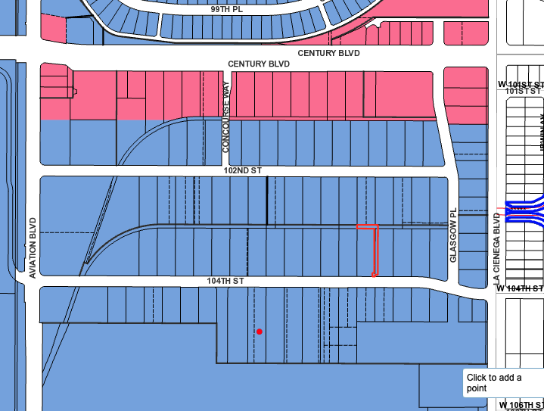
Century-La Cienega / WPDR 34
Notes?
This means all three districts: 33, 34 and 35.
X | [T][Q] M1-1
X | [Q] ML1-1 or ML1-LV (5)
X | MR1-1
80-90 | MR 2-1
X | PF-1

Slide 21
Response: Century-La Cienega / WPDR 34
Questions, Requests for Clarification: | Zoning change proposals you like:
Zoning change proposals you disagree with: | Alternative zoning proposals:

Slide 22
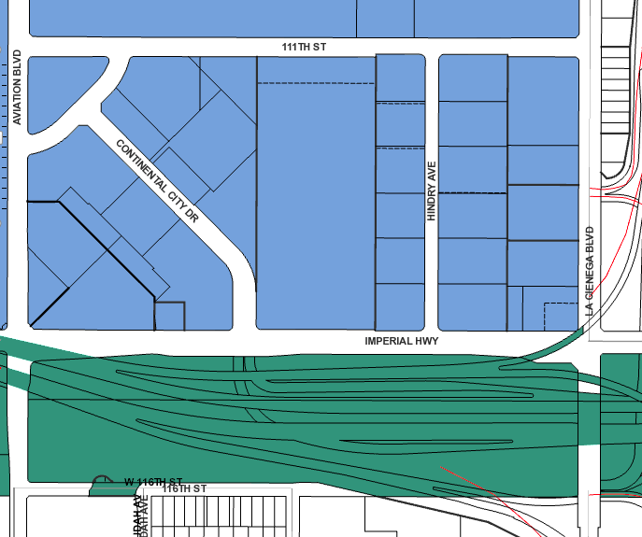
105 @ 405 / WPDR 35
Notes?
This means all three districts: 33, 34 and 35.
3 | [T][Q] M1-1
X | [Q] ML1-1 or ML1-LV (5)
X | MR1-1
18 | MR 2-1
X | PF-1

Slide 23
Response: 105 @ 405 / WPDR 35
Questions, Requests for Clarification: | Zoning change proposals you like:
Zoning change proposals you disagree with: | Alternative zoning proposals:

Slide 24
For further discussion: Are there other current INDUSTRIAL locations in NCWP where you would propose Up-Zoning?
Where?
Why?
What Zone Density Base would you recommend? (See page 7 of this workbook for table of possible Density Base choices.)
Copy this page and make as many as you have suggestions for

Slide 25
RECAP: Notes on Industrial Draft 2 Map

